Slide 1
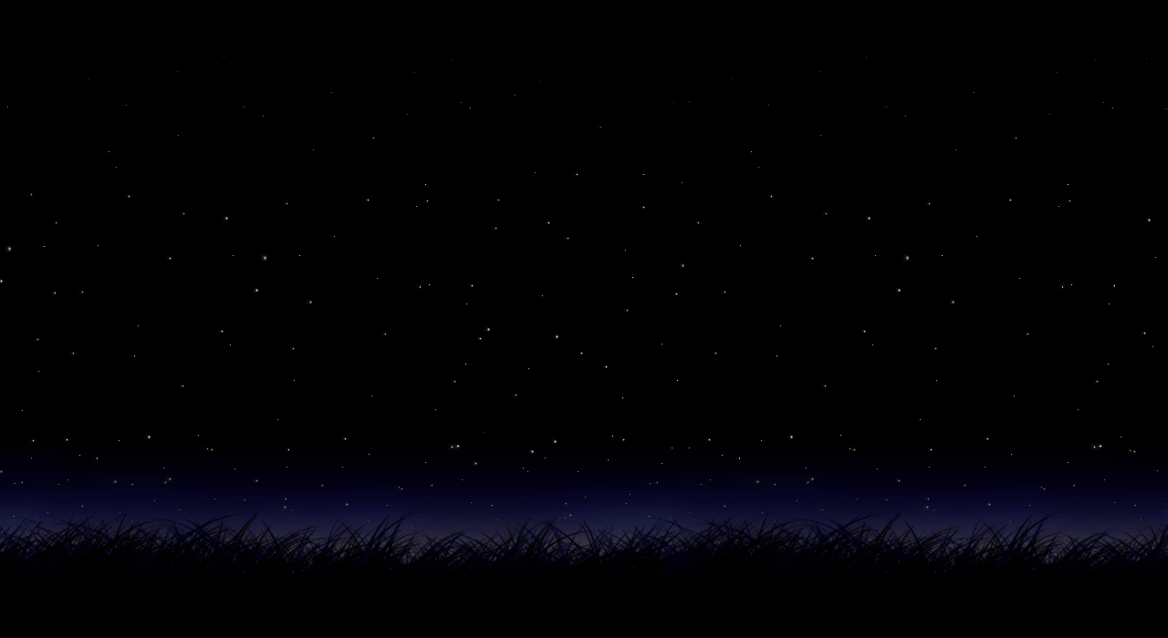
appreciate the day
before it slips away
then appreciate the night
Okay?

